Slide 1

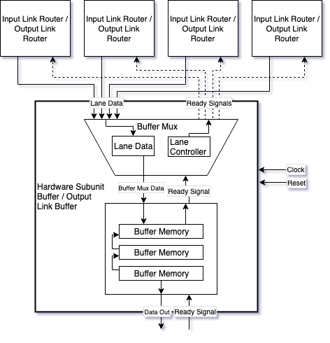
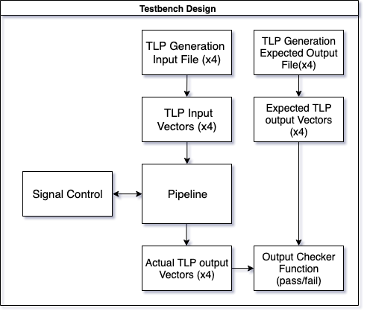
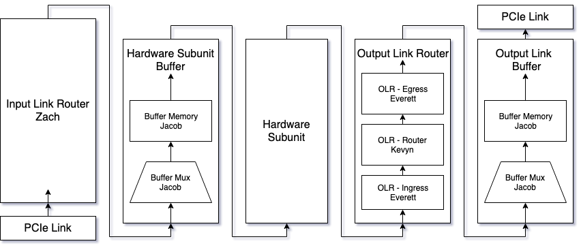

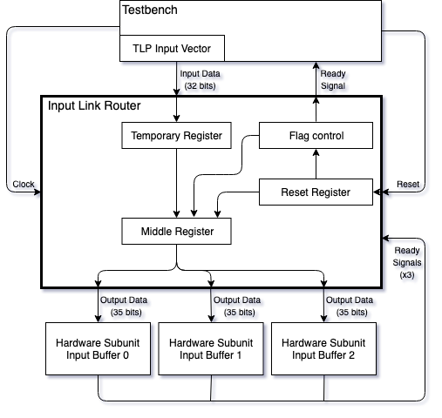
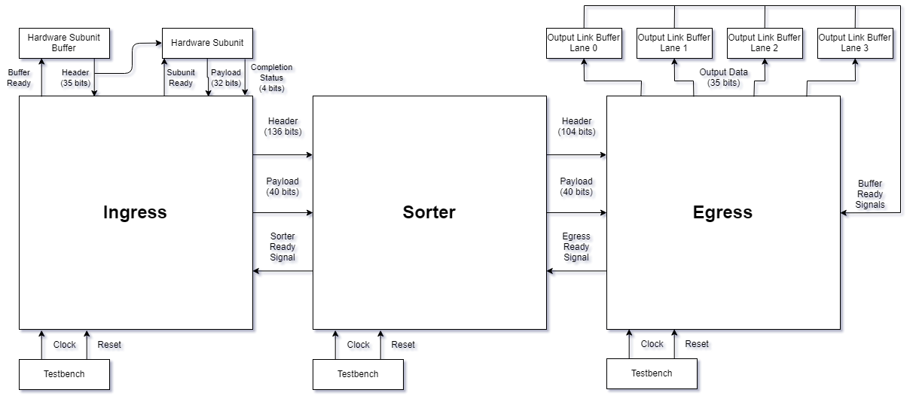
RTL Development of Communication Protocols on FPGA
Stavros Kalafatis
Everett Bullock, Zach Duhon, Jacob Griffin, Kevyn Robins
Department of Electrical and Computer Engineering
Project Overview
The goal of this project is to increase the utilization of accelerators by developing an interface that reduces the latency and increases the bandwidth of current PCIe interconnects. To achieve this goal we aggregated four PCIe lanes by first routing individual packets to discrete hardware subunits then returning the completed results to the originating PCIe lane.
Buffer Subsystem
The Buffer Subsystem is responsible for cycling between lanes, receiving input, and passing that data to the next subsystem. The Buffer Subsystem’s goal is to maintain data flow while the next subsystem might be stalled or completing a task.
Testing and Validation
The pipeline was validated with the use of randomly generated TLPs. These packets were fed into the pipeline with the use of a ‘smart’ testbench. This testbench is able to input the TLPs, read the outputs, and compare those outputs to an array containing the expected results.
Figure 1. System Block Diagram
Input Link Router Subsystem
The Input Link Router is responsible for receiving PCIe requests (TLPs) and sending them to the corresponding Hardware Subunit Buffer (HSB). This task is accomplished by intaking 32-bits of data, reading the data to determine the destination, and outputting the data when the next subsystem is ready.
Figure 3. Buffer Block Diagram
Output Link Router Subsystem
The Output Link Router is responsible for receiving headers from the HSB and payload from the Hardware Subunit, sorting the headers into completion TLPs, and routing the data back to the originating lane.
Figure 5. Testbench Design Block Diagram
Conclusion
A stream of 4,000 randomly generated TLPs was successfully processed and validated by the pipeline and testbench. Furthermore, the flexible design allows for the number of PCIe lanes and hardware subunits to be implementation specific.
v`
Acknowledgments
Special thanks to Stavros Kalafatis and Ping Wang for their guidance and support.
References
Design Automation Standards Committee. IEEE Standard Verilog Hardware Description Language
PCI Express® Base Specification Revision 4.0 Version 0.3. PCI-SIG, 19 Feb. 2014.
Figure 2. Input Link Router Block Diagram
Figure 4. Output Link Router Block Diagram

